Slide 1
Welcome Back – Part 5
Jerusalem Is Rebuilt
Ezra, Nehemiah, Esther, Haggai, Zechariah, Malachi

Slide 2
“That which hath been is that which shall be; and that which hath been done is that which shall be done: and there is no new thing under the sun. Is there a thing whereof it may be said, See, this is new? it hath been long ago, in the ages which were before us” (Ecclesiastes 1:9-10).
“Black Death” spread across Europe in the years 1346-1353, killing an estimated 60 million.
Smallpox outbreak of 1520 killed 5 - 8 million people.
Yellow fever outbreak over the course of spring and summer of 1878 killed an estimated 13,000 - 20,000.
The “Third Plague” of 1855 ultimately led to more than 12 million deaths in India and China, with about 10 million in India alone.
The Spanish flu pandemic of 1918-1919 killed millions. Older estimates say it killed 40 - 50 million people while current estimates say 50 - 100 million people worldwide were killed. In the United States alone, about 28% of the population suffered, and 500,000 to 675,000 died.
Ecclesiastes 7:14 says, “In the day of prosperity be joyful, and in the day of adversity consider.”

Slide 3
Captives Free to Return
536 B.C.
Many Israelites stayed where they were
  It has been almost 200 years since the first captives have been taken from Israel.
  722 BC
  The most recent captives have been gone 50 years
    They built homes and were content
    to stay
  It was their choice whether to return or not.

Slide 4
Background of Haggai and Nehemiah
Ezra 1-6
Captivity
606 BC – First captives taken by Nebuchadnezzar. Daniel 1:1-2
597 BC – Second Group (10,000) taken to Babylon. 2 Kings 24:10-16; Ezekiel 1:1-3
586 BC – Jerusalem falls, temple destroyed.
2 Kings 25:1-21
539 BC – Babylon falls to Medes and Persians.
Daniel 5: 25ff; Isaiah 44:27-45:1-4

Slide 5
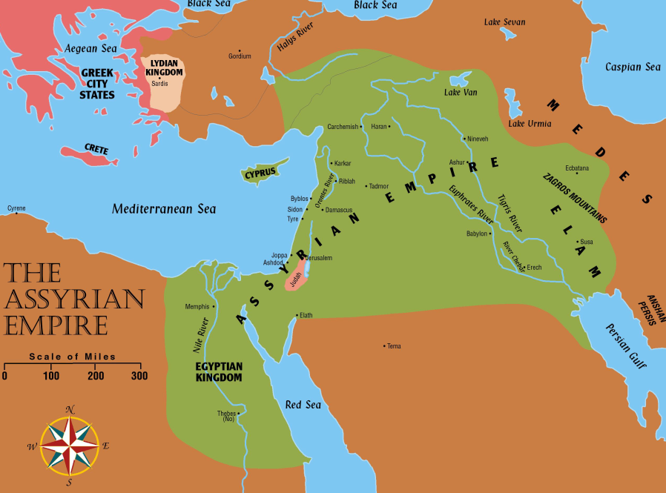
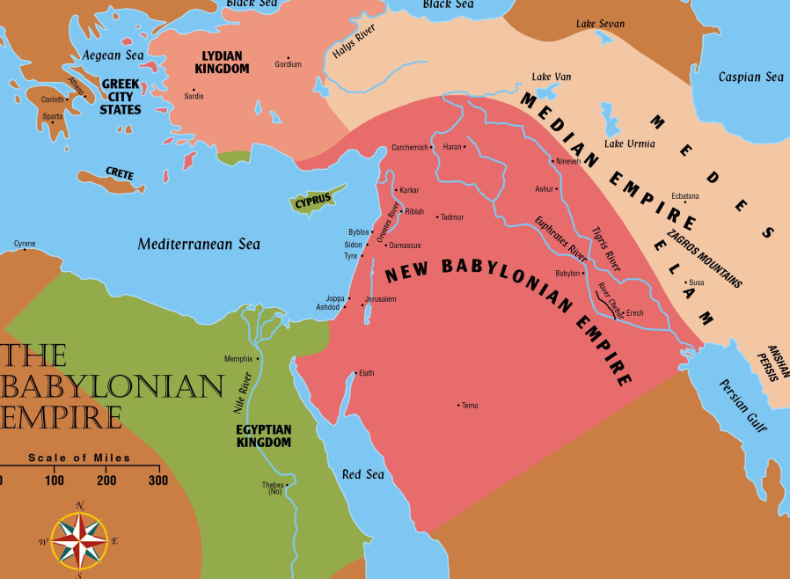
Jerusalem Is Rebuilt
Permission to go home included all the tribes of the Israelites. Ezra 1:3
  Israel (Northern tribes) was scattered throughout the Assyrian empire
  Judah (Southern tribes) scattered in Babylon

Slide 6
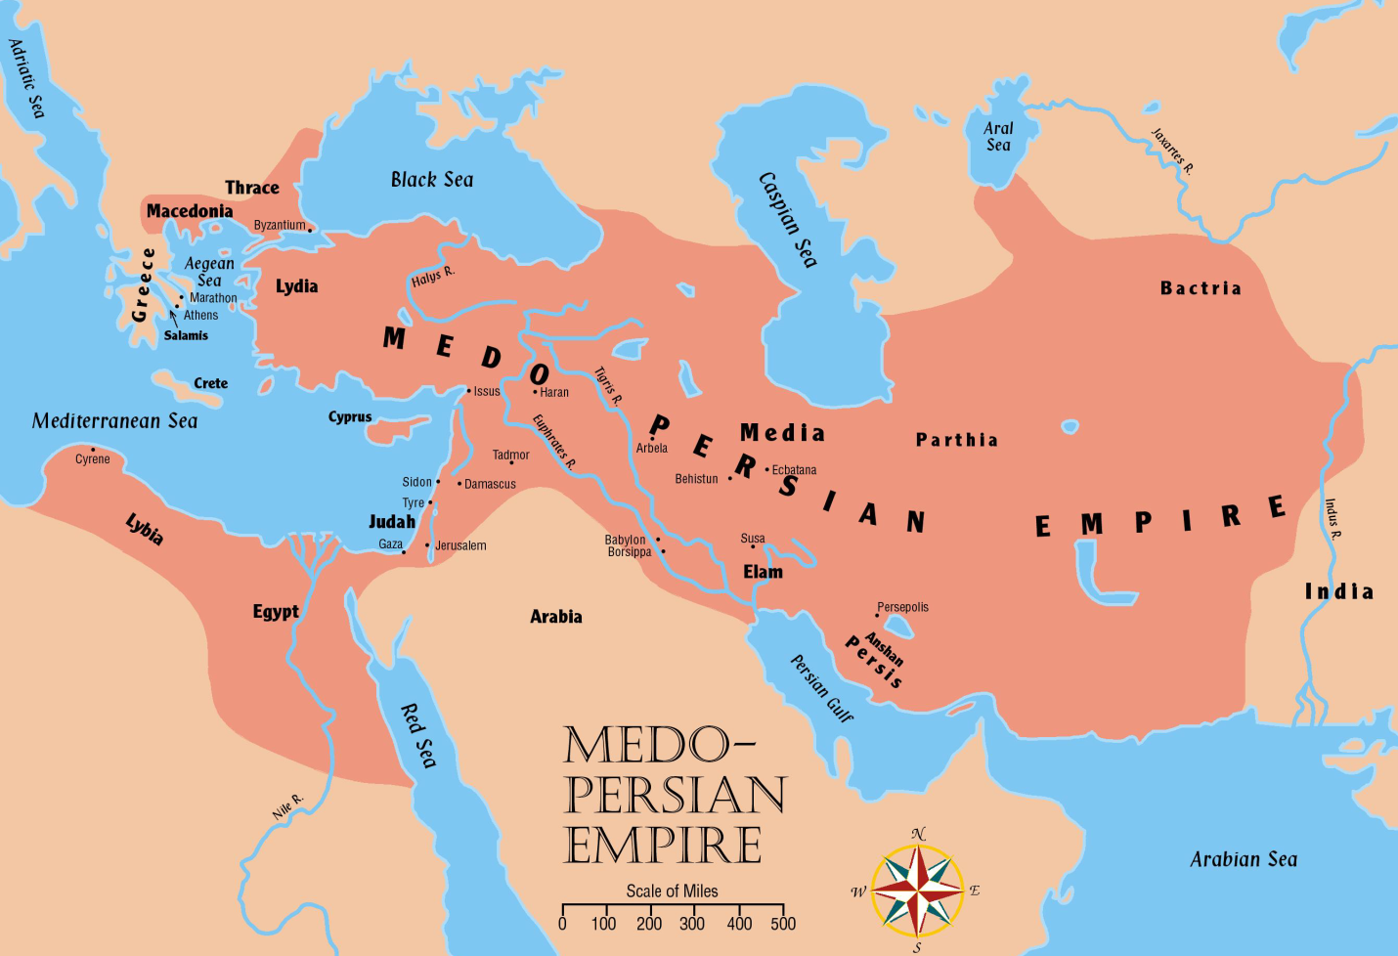
Jerusalem Is Rebuilt
Persia now controls all the territories once held by Assyrian and Babylonian empires

Slide 7
The People of Palestine
They profited from the Jews’ absence
  Samaritans, Ammonites, Edomites, and Nomadic tribes moved into and nearer the
  fertile lands
  Adversaries: Samaritans desired to help build the temple. Ezra 4:1ff; Nehemiah 2:17ff; cf. 2 Kings 17:32.
  Jews accused of treason. Ezra 4:6ff; 11ff

Slide 8
The “three returns” in Ezra and Nehemiah and Background of Haggai and Nehemiah – Ezra 1-6
Restoration
536 BC – Cyrus issues a decree (538 BC) for the Jews to go back to Jerusalem; after 70 years.
(cf. Jeremiah 25:11; 29:10-14)
  Almost 50,000 return under the leadership of Zerubbabel
  (2 Chronicles 36:21-23; Ezra 1; 2:64-65)
520- 516 BC – The temple is completed.
Ezra 6:15; cf. Ezra 3:10ff; cf. Haggai 2:3
457 BC – Ezra led a second remnant of 2,058 Jews to Jerusalem. Ezra 8:1-34
444 BC – Nehemiah lead a third remnant back.
Nehemiah 2

Slide 9
Persian Kings
These rulers cover the period of restoration during the time of: Ezra, Nehemiah, Esther, Haggai, Zechariah, and Malachi.
Cyrus (559-529 BC) Conquered Babylon in 539 BC with Darius the Mede. Daniel 5:30-31
Cambyses (529-522 BC) Also called “Artaxerxes” Commanded work on temple to cease.
Ezra 4:7, 11, 23

Slide 10
Persian Kings
These rulers cover the period of restoration during the time of: Ezra, Nehemiah, Esther, Haggai, Zechariah, and Malachi.
Darius I (522-486 BC) Authorized the completion of temple. Ezra 4:24-6:15, Book of Haggai
Xerxes (485-465 BC) Also called “Ahasuerus”
– Esther was his queen, Book of Esther.
Artaxerxes (465-425 BC) Authorized Nehemiah to rebuild Jerusalem, Ezra 7; Book of Nehemiah.

Slide 11
Esther
Takes place approximately between chapters 6 and 7 of the book of Ezra.

Slide 12
Haggai
“Consider Your Ways”

Slide 13
Nehemiah
A Man Of Action

Slide 14
Interest In His Brethren
1:2 – Asked concerning the condition of his brethren.
1:4ff – Prays for the people.
1:11 – Prays for himself.
2:4 – Prays for the right answer.
Power of prayer. James 5:16

Slide 15
Preliminary Preparation
2:3-8 – Petitions the king
Send ME to Jerusalem.

Slide 16
The Work Of Rebuilding
2:9-20 Preparation –
  Views the city, reveals his mission.
  Ridicule.
Chapter 3 – Assignments given for the work.

Slide 17
The Work Of Rebuilding
The Zeal Of The Work.
  4:1-3 Ridicule.
  4:6 – “The people had a mind to work.” cf. Haggai
  4:9, 16 Watch.
  4:17 Worked with one hand and held their weapons with the other hand.
  4:18 Trumpet blower by Nehemiah … leadership and cooperation.
  4:20 Faith in God. “Our God will fight for us.”

Slide 18
The Work Of Rebuilding
The Greatest Interference To Their Work Was Internal Strife. 5:1-6
5:9 – “The thing that ye do is not good.”
  Ephesians 4:3; Psalms 133:1; 1 Thessalonians 5:12-13; Galatians 5:15
5:12 – People promise to repay.
5:14-19 – Example of Nehemiah.

Slide 19
The Work Of Rebuilding
Uncompromising Work.
  First effort to get Nehemiah to compromise: 6:1-9
    “I am doing a great work … I cannot come …”
  Second effort to get Nehemiah to compromise: 6:10-14
The Work Finished. 6:15 Fifty two days.

Slide 20
The Work Of Registering and Educating The People
7:1-73 – People registered according to genealogy.
8:1-8 – Law read to the people.
8:10ff – People react to the reading of the law.
cf. Ezra 9 - 10
9 – Public confession of sin.
10 – People make a covenant to keep the law.

Slide 21
The Work Of Populating The City
11 – One out of every ten to dwell in Jerusalem.

Slide 22
Dedication Of The Walls
12:27 – A grand occasion. Great celebration!
12:31 – The princes of Judah went upon the wall.
12:43 – Day of rejoicing, singing, praying, thanksgiving. “Heard even afar off.”

Slide 23
“When The Cat Is Away …”
Nehemiah 13:6
13:4-5 – Tobiah, given quarters in the temple courts by Eliashib the (high – 13:28) priest.
13:10-11 – Levites abandoned their posts in the temple.
13:15-17 – People profaned the Sabbath day.
(cf. chapter 10)
13:23ff – People had engaged in mixed marriages.
Ezra (9:3) versus Nehemiah.

Slide 24
Conclusion:
We should be like Nehemiah.
Work or act now, cry later.
Develop the mind to work, despising internal strife.
Learn to accept the example and zeal of Nehemiah.
13:31 – “Remember me, O my God, for good.”

